Slide 1
FIFA-19 ANALYSIS

Slide 2


TEAM PRESENTATION
AARSH SAPRA AUTHOR 1
RACHIT AGARWAL AUTHOR 2

Slide 3
Introduction
1
Objectives ,architecture and procedures.

Slide 4
The greatest value of a picture is when it forces us to notice what we never expected to see.

Slide 5
OBJECTIVE
To analyze the given data of the popular game fifa-19 , and create a story to visualize the relationship between different attributes and draw out the key performance metrics for each player while making the dashboard interactive to enable the user to draw their own insights.

Slide 6
BENEFITS
Anyone can easily compare their favourite players analyzing their strengths and weaknesses.
The project also enables the user to figure out best players of each club enabling them to create their own best 11.
The project scales well to new data entries and thus can be reused in the future.
The correlation between age and performance is applicable in real life as well and thus can help the managers to assess when players reach their peak performance

Slide 7
DATASET DESCRIPTION
data.csv file provided by ineuron ,data is scraped from https://sofifa.com/.
Dataset has 88 columns and 18207 rows.
Contains information about their name , age ,height , weight, nationality , club , value and wage.
Information about body type, international reputation , preferred and weak foot ,contract validity.
Different statistical scores and attributes to assess their performance as integers.

Slide 8
WORKFLOW DIAGRAM

Slide 9
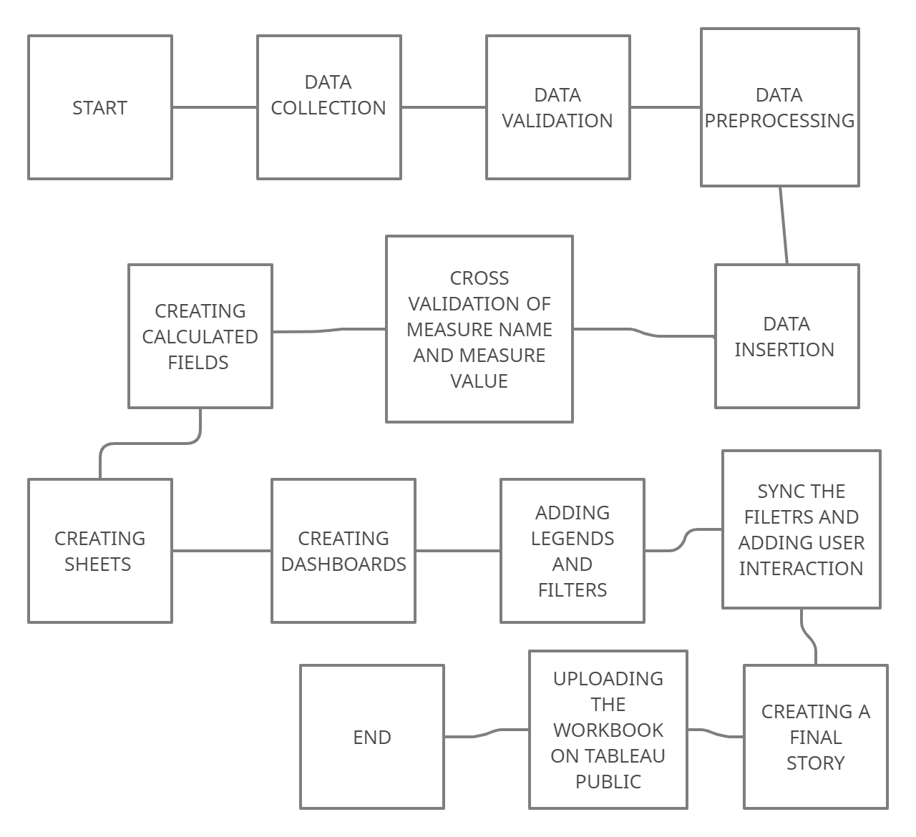

Slide 10
DATA VALIDATION AND PREPROCESSING
Dataset has missing values which are imputed or dropped accordingly.
Data type Validation: Wages and values are in strings and are therefore transformed into integers to compute their summary statistics.
Cross Validation of categorical columns to find any inconsistencies.Body type column has 3 anomalies which were corrected.

Slide 11
Data insertion into Tableau
Note: Mysql database connection is unavailable in Tableau public free
We can directly open the csv file in tableau.
Then we extract the data from the file creating a local data source in Tableau for the given project.
We also create a copy of the dataset and use inner join to combine the two and pivot certain columns for further analysis.
Once data is inserted we get measure names - discrete and categorical values
And measure values - continuous values to plot our visualizations

Slide 12
Calculated Field into Tableau
Rating - REPLACE(SPACE([International Reputation]),"","★"
)+""+REPLACE(SPACE(5-[International Reputation])," ","☆") - To replace the number with stars
Radar chart calculated fields - To draw the radar chart we pivot the attributes we need and create 4 calculated fields - Angle , Distance from the centre and X, y coordinates.
Fifa card attributes - We compute each attribute of the fifa card such as pace, shooting , dribbling , passing , physical , defence using the attributes given in the csv files
Logos for the clubs - Top club logos are also imported into tableau and saved in the shapes folder of my tableau repository.

Slide 13

A PICTURE IS WORTH A THOUSAND WORDS
Processing many records in a spreadsheet becomes easier when you visualize it in a graph
New insights from different perspectives .

Slide 14
We create three dashboard each analyzing different aspects of the game and the players .
From these we build an interactive story that lets user draw their own insights while we highlight the relevant features that intrigued us while working on the dataset.

Slide 15
GENERAL OVERVIEW
Our first Dashboard aims to give a general overview of the data and highlight some the important correlations between different factors.
First we create a geographical map by dropping the auto-generated latitude and longitude filed , sizing by the number of players in each country.
Second we create a bar chart for top 10 players with the highest wages in fifa-19.
Lastly we create two scatter plots to show correlation between overall and potential as well as age and the earnings of a player.
We add images and shapes to make dashboard more intuitive and creative and add a context filter for nationality
User can also filter by clicking on the map created.

Slide 16
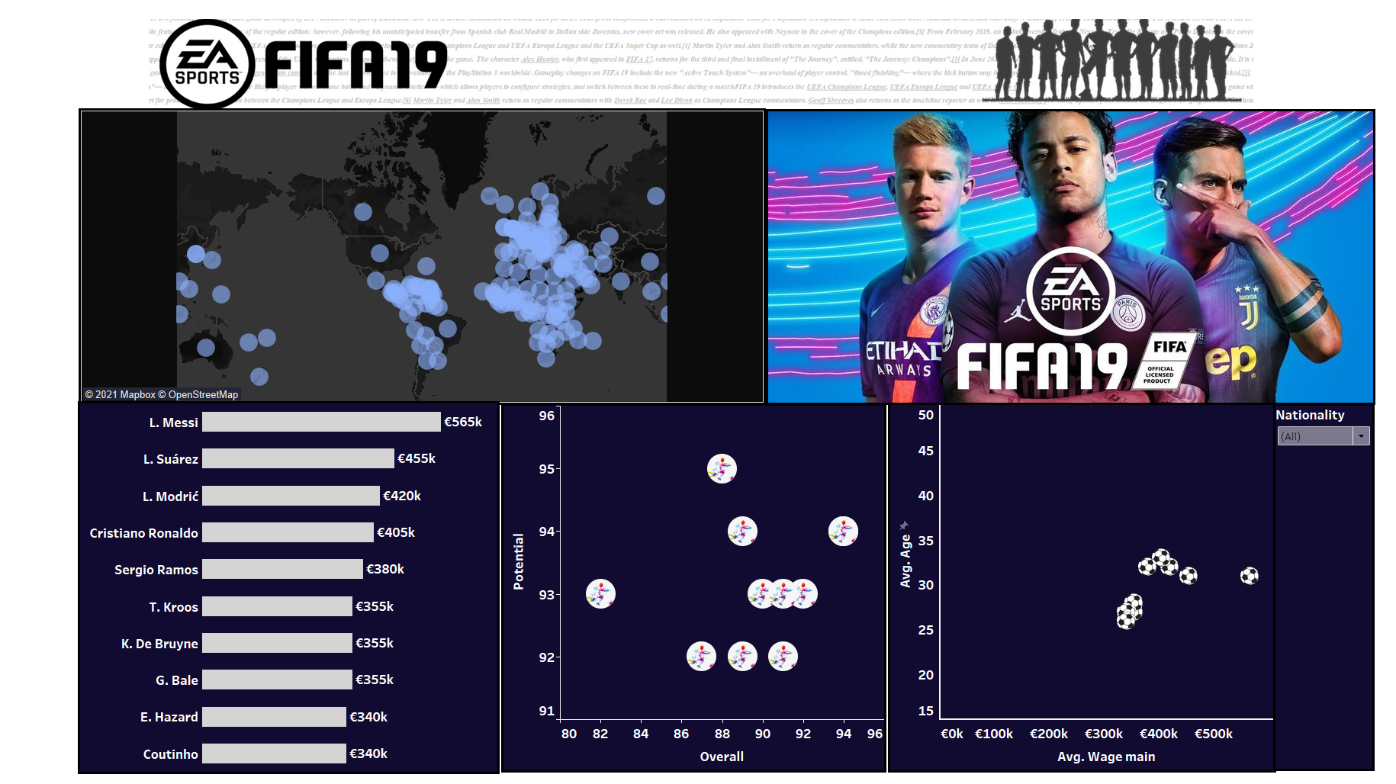

Slide 17
TOP 3 PLAYERS
Our second Dashboard shows top 3 players based on overall performance for top 50 clubs of the world.
We import fifa card image on the dashboard and drag the relevant data created as separate sheets on the image as floating and position and size them accordingly
We also add the three radar chart for each of the 3 top players.
We add some text and images to give it a modern look
We add context filter for the club which let’s the user choose their favorite club.
Based on the club , different fields are computed and stats are rendered and logo is also filtered along with the international rating.

Slide 18
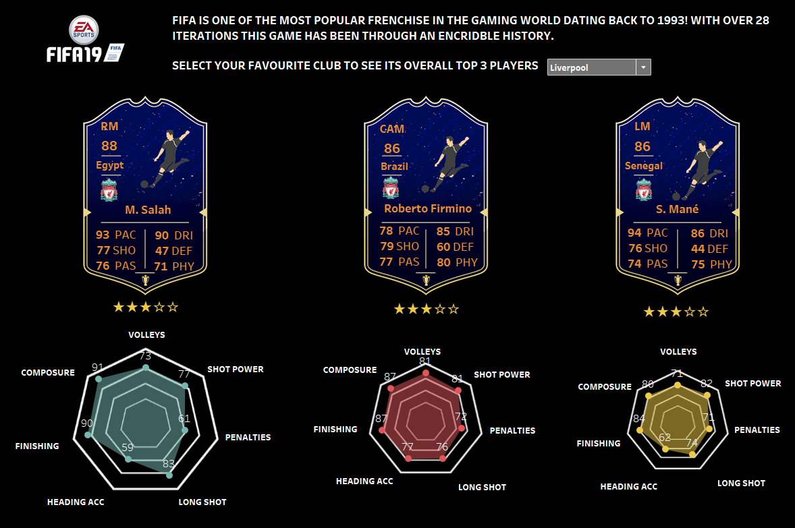

Slide 19
1V1 COMPARISON
Our final Dashboard allows the user to compare their favorite players and figure out who is better.
Firstly we add a image which serves as a placeholder for all the information .
Secondly we add text for each field on basis of which the players are to be compared.
Lastly we create a dual axis bar chart using a calculated field of 100 to scale all the values and for each attribute we create the bar chart score.
We customize the layouts and add filter for the club and the player of that club which user can select and compare.

Slide 20
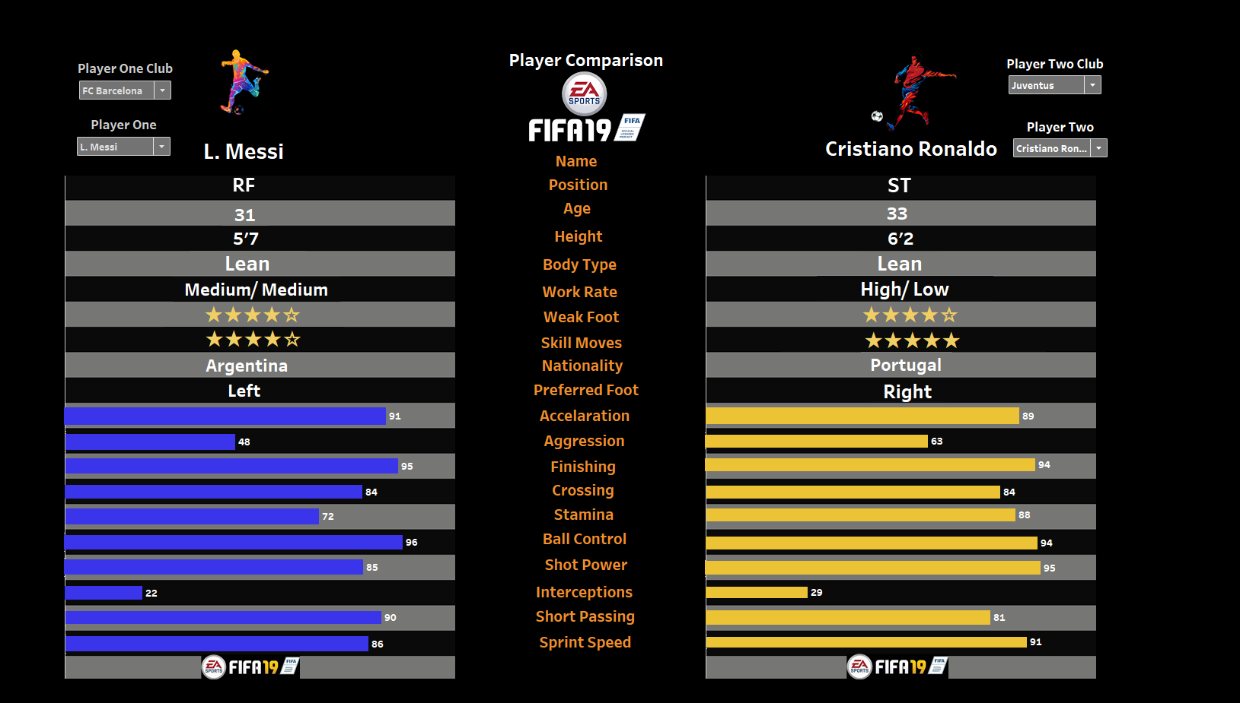

Slide 21
TREND ANALYSIS
2

Slide 22
18207 players
651 clubs
164 nations
Another successful season!

Slide 23
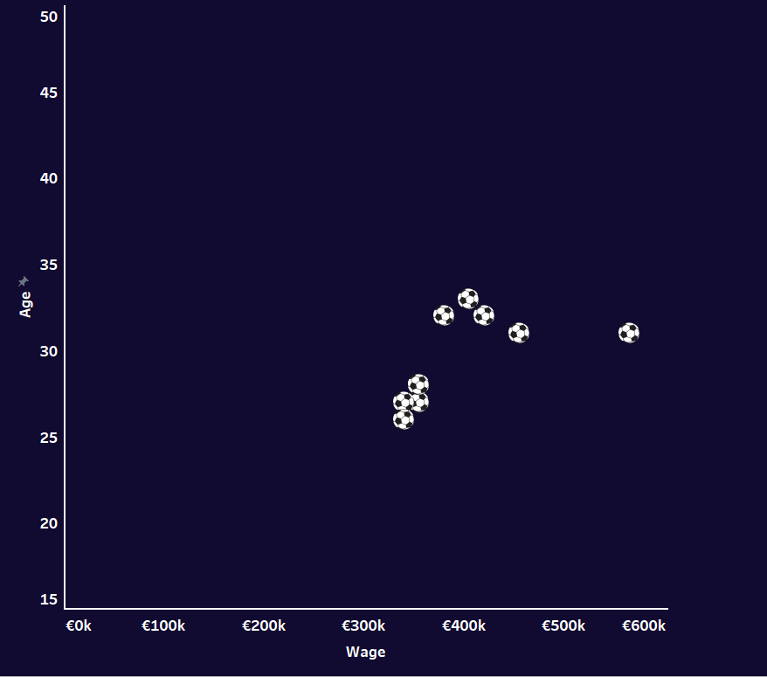
OVERALL TRENDS
We find that players reach their peak performance around age 30.
Majority of clubs belong to Europe and Africa .
Messi is the highest earning player with 565k euros wage.
241 players are not part of any club.

Slide 24
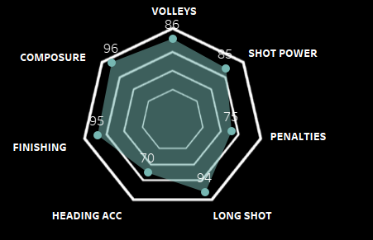
SKILLS OF TOP PLAYERS
Top Players of every clubs have good overall with uniform and high stats in for all attributes.
Only some teams have goalkeeper as one of their top players.
Defence stats of center forward player is generally less with higher sprinting speed and shot power.
Goalkeepers are compared on basis of different attributes than players at other position.

Slide 25
WHO IS THE BEST...
Both Messi and Ronaldo have same overall score of 94.
Between Messi and Ronaldo, Ronaldo has higher stats in almost all attributes except Acceleration and Short passing.
Ronaldo’s height also gives him a significant advantage along with more diverse skill moves.
Hence we conclude that Ronaldo is G.O.A.T

Slide 26
THANKS!
REGARDS:
AARSH SAPRA
RACHIT AGARWAL

